Slide 1

Water Quality Assessment Procedures for Virginia: Dissolved Oxygen Assessment of Lakes and Reservoirs
Cayelan Carey & Whitney Woelmer
21 May 2020

Slide 2
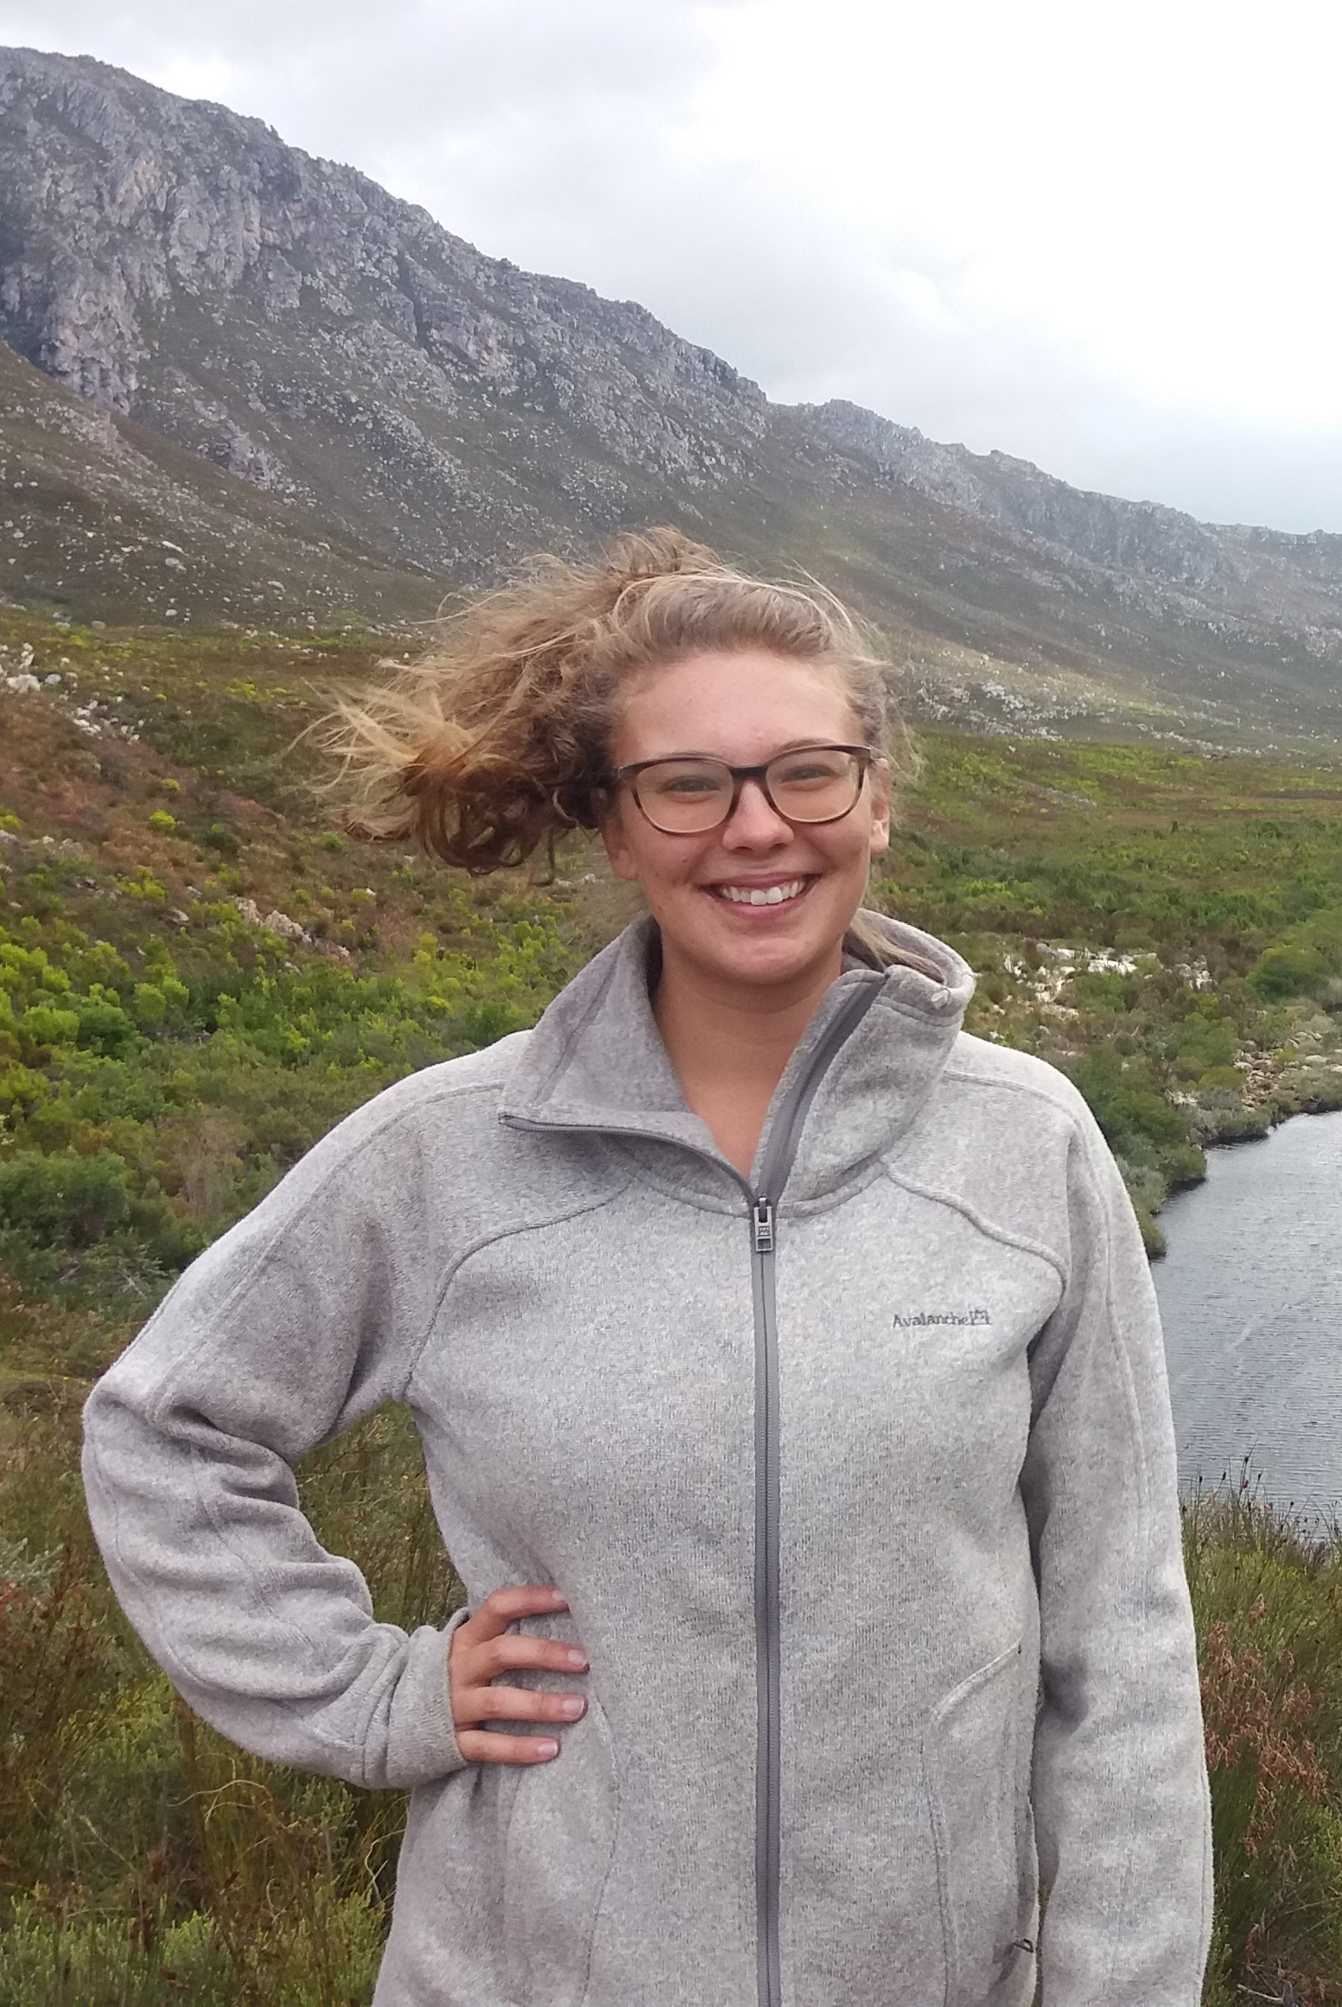
Background Expertise
Dr. Cayelan Carey
Whitney Woelmer, PhD Student, VT
3 years at USGS studying Great Lakes food web and water quality dynamics
Extension Agent for Peace Corps Zambia managing fisheries and water quality for Department of Fisheries in rural Zambia

Slide 3
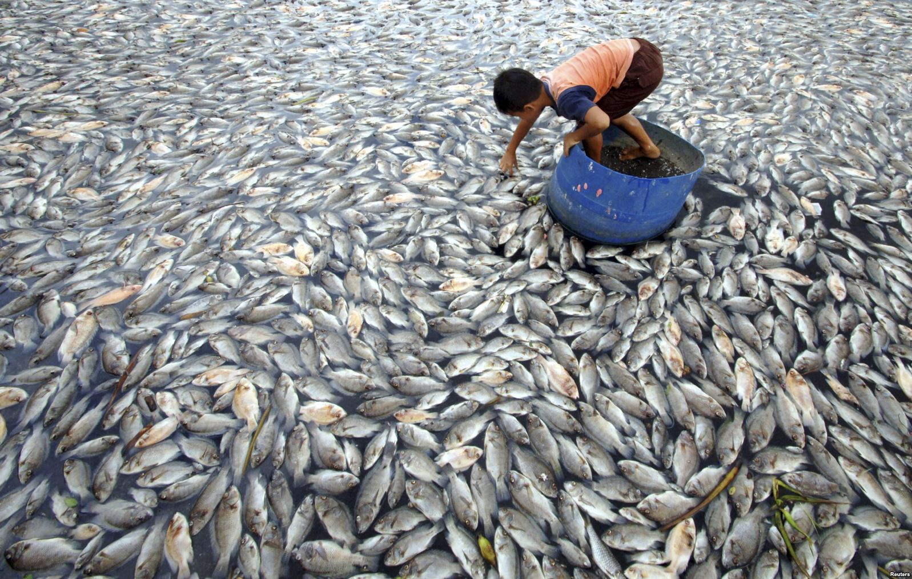
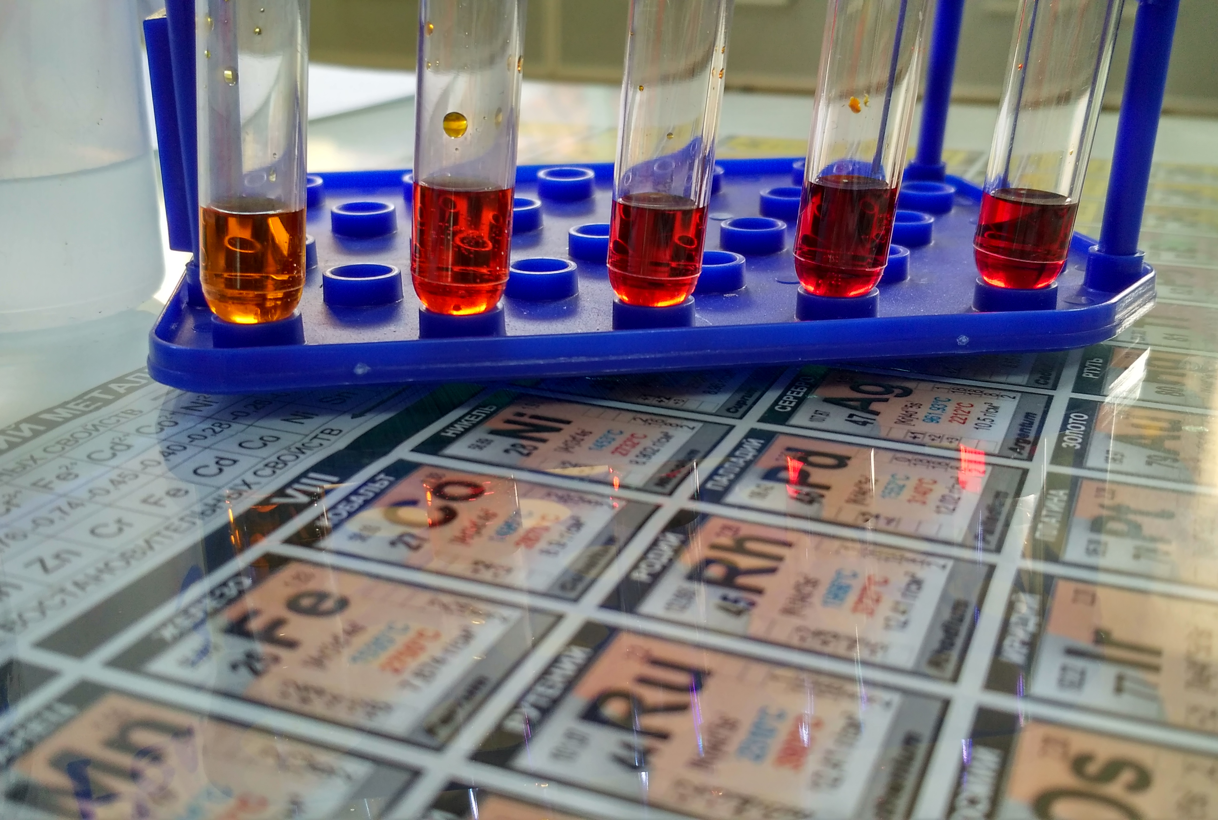
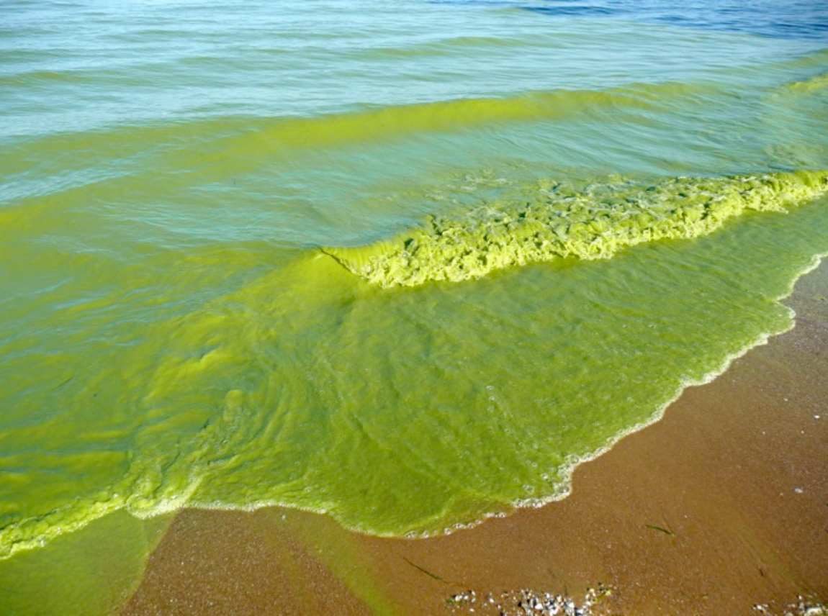
Dissolved oxygen (DO) is the most important metric of lake water quality
Govern the habitat and behavior of aquatic organisms
Promote the release of nutrients and metals
Is an indicator of other ecological processes

Slide 4
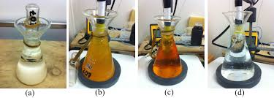
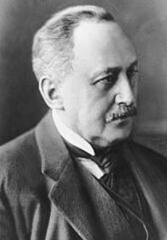
DO may be quantified as mg/L or % saturation
Winkler method developed in 1888 provided a mass concentration in mg/L
Previously, % saturation previously difficult to estimate?
Now % saturation is available on most handheld devices, and has become a critical metric by which to assess water quality
Notes:
maybe go into this here by first starting with something like 'DO was one of the first metrics to be measured by limnologists (an old picture of Winkler?), and was first done by the Winkler method, which provides a mass concentration, mg/L. Now that % saturation is much easier to measure and is on all handheld devices, it has became a critical metric by which to assess water quality. Then go into the differences and how temperature is related

Slide 5
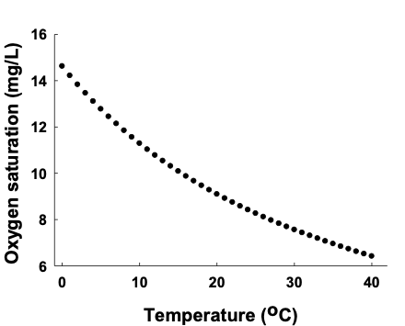
DO may be quantified as mg/L or % saturation
Percent saturation ranges from 0% (no oxygen present) to 100% (in equilibrium with atmospheric oxygen concentrations)
Oxygen solubility increases with water temperature, so important to measure both when comparing DO conditions across waterbodies
This is especially important for waterbodies which BLAHBLAH
Notes:
The dotted line shows 100% saturation for each water temperature from 0 to 40 degrees Celsius.

Slide 6
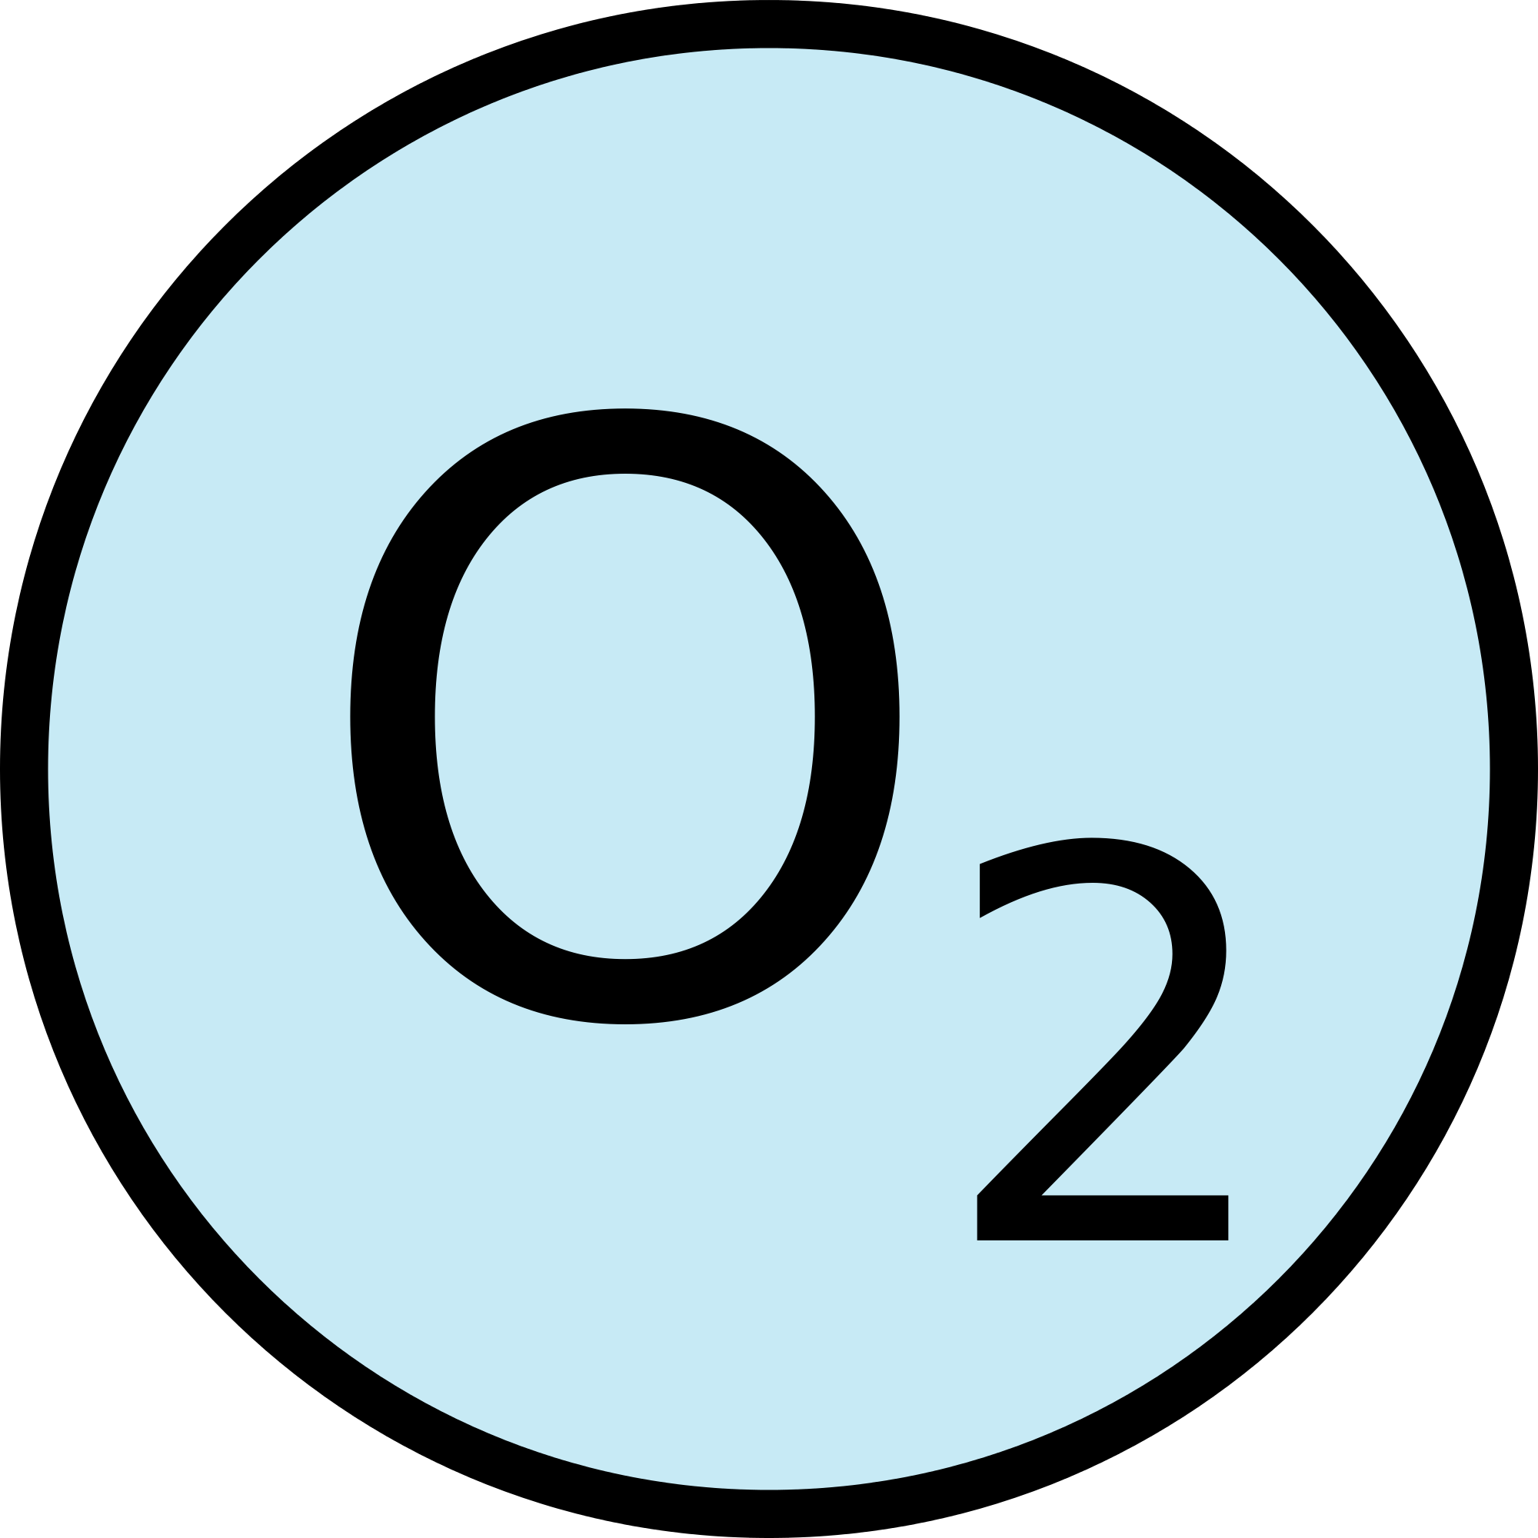




DO serves as a ‘gatekeeper’ for many ecological and biogeochemical processes
Atmospheric Exchange
Photosynthesis
Respiration
Decomposition
Notes:
Cayelan, this slide needs a lot more formatting work, which I didn’t want to spend too much time on yet before getting your feedback. The general flow would go something like this:
Different processes happen at different depletion levels, something about fish dying here
-DO is both a response and driver of many ecological and biogeochemical processes
-DO is usually high in surface waters due ot atmospheric exchange and photosynthetic production
-however, due to thermal stratification, reservoirs typically have distant thermal layers, epi and hypo, which do not fully mix. This often leads to much lower oxygen in the hypolimnion, as oxygen is used up for decomposition of organic material
-when oxygen is low in the hypolimnion, nutrients and heavy metals are often released from the sediment, which can then become mixed into the upper layers of the water column

Slide 7



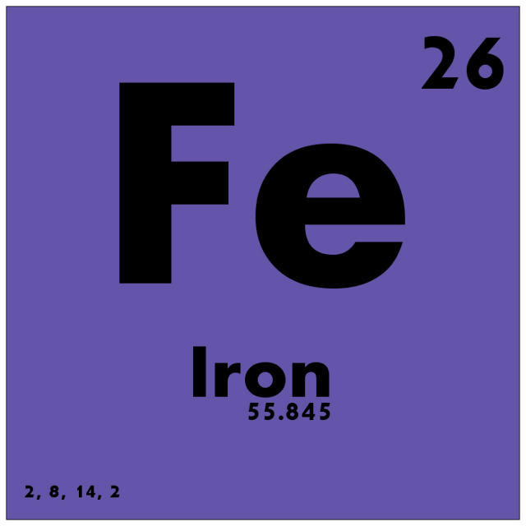

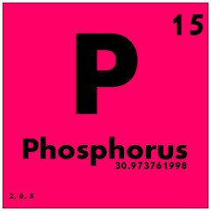
Different processes govern oxygen availability in stratified waterbodies
External Organic Material
Atmospheric Exchange
Epilimnion
Photosynthesis
Warm
Respiration
Low dissolved oxygen, hypoxia
Hypolimnion
Decomposition
Cold
Notes:
Cayelan, this slide needs a lot more formatting work, which I didn’t want to spend too much time on yet before getting your feedback. The general flow would go something like this:
-however, due to thermal stratification, reservoirs typically have distant thermal layers, epi and hypo, which do not fully mix. This often leads to much lower oxygen in the hypolimnion, as oxygen is used up for decomposition of organic material
-when oxygen is low in the hypolimnion, nutrients and heavy metals are often released from the sediment, which can then become mixed into the upper layers of the water column
-so while photosynthesis and atmospheric exchange can keep DO levels high in the epilimnion, processes such as decomposition and respiration of microbes dominate DO levels in the hypolimnion

Slide 8
Stratification regimes in lakes are changing globally
Hypolimnetic DO availability is decreasing lakes and reservoirs globally
The dominant driver of this pattern is increased levels of high nutrient runoff
Increases in salt pollution have altered mixing regimes, leading to incomplete or delayed fall turnover
Warmer air temperatures can lead to warmer surface water temperature, increasing the energy needed for fall turnover

Slide 9
Reservoirs may be especially susceptible to global change effects
Large amounts of organic matter buried in sediments
Typically larger watershed to surface area ratio
Man-made impoundments typically located near large populations and at lower latitudes
In general, reservoirs are understudied, but their relevance to society means proper monitoring and management is critical

Slide 10
(1) Is DEQ’s current procedure for DO assessments in lakes/reservoirs sound and scientifically defensible? Does the AAC have any concerns about this procedure besides those already mentioned?
It is critical to assess DO in both the epilimnion and hypolimnion
Spatial monitoring of DO along the reservoir continuum provides valuable information
Temporal averaging should be done on short time scales, so as not to mask emerging patterns
The current DO threshold of 4.0 mg/L should be lowered to 3.0 mg/L

Slide 11
(1) Is DEQ’s current procedure for DO assessments in lakes/reservoirs sound and scientifically defensible? Does the AAC have any concerns about this procedure besides those already mentioned?
The current DO threshold of 4.0 mg/L should be lowered to 3.0 mg/L
3.0mg/L represents a level at which most aquatic life is at risk
3.0 mg/L represents 50% saturation, which is our recommended benchmark

Slide 12
(3) Is there another alternative approach that DEQ should consider?
At every current lake/reservoir assessment unit site, measure a full water column temperature and DO depth profile from the subsurface at 0.1 m on every meter interval to the nearest integer meter depth above the sediments. Dissolved oxygen should be measured in mg/L and percent saturation.
Establish the depth of the thermocline at that site, if it exists to delineate epilimnion and hypolimnion. If there is no temperature change between depths of at least 1ºC, then we propose treating the entire water column as one integrated layer for the steps below.

Slide 13
(3) Is there another alternative approach that DEQ should consider?
For each site individually, determine median DO concentration of the epilimnion. Exceedances within the epilimnion are defined as DO concentrations <3.0 mg/L (see Table 2 as an example).
For each site individually, determine the median DO concentration of the hypolimnion. Given the likelihood of DO depletion in the hypolimnion of most reservoirs that is inherent to their construction (see above), we further propose using the <3.0 mg/L threshold for hypolimnetic DO exceedances.

Slide 14
(3) Is there another alternative approach that DEQ should consider?
If there is no temperature change between depths of at least 1ºC, the entire water column should be treated as one layer. In this case, determine if the median DO concentration of the entire water column on a sampling day is below the DO exceedance threshold of 3.0 mg/L.
If there is more than one monitoring site within a lake/reservoir assessment spatial unit, aggregate epilimnetic DO concentrations among sites within a spatial unit. This aggregation should be calculated by taking the overall median of the median epilimnetic DO concentrations per site within each lake/reservoir assessment spatial unit for a sampling day.
If there is more than one monitoring site within a lake/reservoir assessment spatial unit, aggregate among hypolimnetic DO concentrations among sites within a spatial unit. This aggregation should be calculated by taking the overall median of the median hypolimnetic DO concentrations per site within each lake/reservoir assessment spatial unit for a sampling day.

Slide 15
(3) Is there another alternative approach that DEQ should consider?
If either the median epilimnion or hypolimnion DO concentration of a lake/reservoir assessment spatial unit on a monitoring day is less than the 3.0 mg/L DO threshold, then that spatial unit as a whole is considered to exhibit an exceedance on that day. It would still be considered only one exceedance (not two exceedances) if both layers on the same day had median DO concentrations less than the threshold.
Calculate the total number of spatial unit-sampling days (i.e., the total number of days in which each spatial unit within a waterbody was sampled) over a maximum two-year (not six-year) rolling-window assessment period. For example, if there were three spatial units within one lake and each were measured on 7, 4, and 12 sampling days, respectively, over two years, then there would be 23 total spatial unit-sampling days in that two-year assessment period. The exceedance rate is then calculated as the number of times in which any sampling site exhibited an exceedance over the total number of spatial unit-sampling days (see Figure 3 as an example).

Slide 16
(3) Is there another alternative approach that DEQ should consider?
A waterbody is considered impaired for DO if the exceedance rate is >10% for the two-year assessment rolling-window period.
For calculating descriptive statistics in additional DEQ reports, aggregate data first to calculate month-medians prior to additional analyses vs. pooling all data equally within a year.

Slide 17
Example of determining thermocline and aggregating DO by epi and hypo
Table 2. A hypothetical temperature and DO depth profile from a monitoring site.*
Depth | Temperature (degrees C) | DO (mg/L) | % DO saturation
0.1 | 28.0 | 7.8 | 100
1.0 | 27.5 | 7.7 | 98
2.0 | 27.0 | 7.7 | 96
3.0 | 26.5 | 7.6 | 95
4.0 | 18.0 | 5.8 | 61
5.0 | 16.0 | 5.5 | 56
6.0 | 15.0 | 5.2 | 52
7.0 | 14.0 | 2.3 | 22
8.0 | 13.0 | 1.6 | 15
Notes:
Example of determining thermocline and aggregating DO by epi and hypo

Slide 18
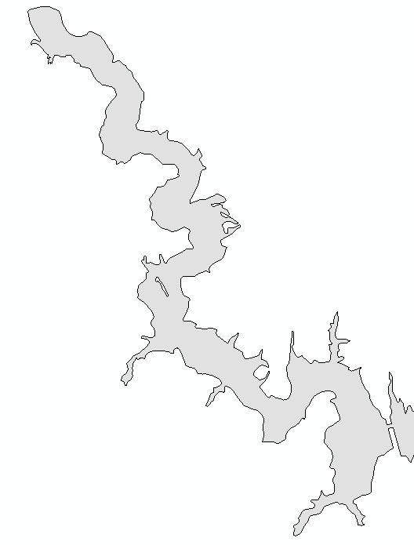
Spatial Example
Spatial Unit A (DEQ)
- 7 sampling days during 2-year period
- 1 day with either an epilimnetic or hypolimnetic DO exceedance
Spatial Unit B (Non-Agency)
- 4 sampling days during 2-year period
- 0 days with either an epilimnetic or hypolimnetic exceedance
DO Assessment Summary
7 + 4 + 12 = 23 spatial unit-sampling days
1 + 0 + 1 = 2 days with epilimnetic or hypolimnetic exceedances
Exceedance rate = 2/23 = 8.7%<=Criterion Attained
Spatial Unit C (DEQ)
- 12 sampling days during 2-year period
- 1 days with either an epilimnetic or hypolimnetic DO exceedance
Notes:
Walk through example of spatial unit DO assessment

Slide 19
(4) Should DEQ restrict DO assessments to vertical profile datasets in lakes/reservoirs or is it appropriate for a surface-only DO dataset to form the basis of an assessment for a lake/reservoir? If the latter, how should surface-only data (or data from shallow profiles) be used in assessments?
It is critical that a full water column profile be used for DO water quality assessment, so we strongly recommend against using a surface-only DO dataset.
As described earlier, we propose a modified DO threshold for both the epilimnion and hypolimnion (<3.0 mg/L), which follows the EPA’s threshold for categorizing water quality (U.S. EPA 2017).

Slide 20
(5) Can the AAC recommend a set of instructions that staff could use 1) to determine whether exceedances at a station are due solely to incomplete fall turnover?
A determination of whether incomplete fall turnover has occurred could be made using a time series analysis.
Assess the magnitude of thermal stratification, recent air temperature patterns, water temperature and DO in the epi- and hypolimnion
If water temperature differences between the hypolimnion and epilimnion are still >1°C, it is likely that fall turnover is incomplete or has not yet occurred. This result would necessitate additional sampling events into later autumn to determine if fall turnover was incomplete or delayed.
Our proposed new sampling protocol would capture the distribution of DO concentrations between the two water layers, rather than only showing a decrease in DO in the epilimnion during incomplete turnover

Slide 21
(5) Can the AAC recommend a set of instructions that staff could use 2) to determine to what degree low DO during fall turnover might be exacerbated by pollution?
Low DO conditions during incomplete fall turnover are often related to pollution from nutrients (nitrogen and/or phosphorus) and/or salt.
High ratio of watershed area to reservoir surface area, reservoirs often receive a substantial amount of runoff
Historical eutrophication of waterbodies was common throughout Virginia, hypolimnetic anoxia can promote their release years after the nutrients entered the waterbody
Given that historical pollution can potentially have long-term effects on current DO conditions, it would be challenging to disentangle the relative effects of current pollution on a waterbody without a detailed time series of the waterbody's pollution record.

Slide 22
(5) Can the AAC recommend a set of instructions that staff could use 3) to downweight fall turnover DO data while still being protective of living resources?
Dissolved oxygen concentrations are important to aquatic life throughout the year so we do not recommend down-weighting low DO concentrations in the autumn months
Low DO conditions can promote the release of nutrients and metals from the sediments into the water column, further exacerbating poor water quality, which should be monitored and reported.
Thus, it is critical that DO availability throughout the year be included in lake/reservoir water quality assessments.
Notes:
Dead fish pictures!

Slide 23
We welcome questions and feedback on the proposed protocol Thank you!

Slide 25
Current DO monitoring protocol
124 lakes/reservoirs monitored every year by VA DEQ
137 spatial units total (some big lakes have multiple ”lake reservoir spatial assessment units”, with multiple sites within a spatial unit)
At each waterbody, collect temperature profile to determine thermal stratification. If not stratified, monitor DO throughout the water column.
If stratified (determined by a thermal difference > 1oC/meter), then monitor DO only in epilimnion.
Use a 4.0 mg/L DO monitoring threshold for an exceedance
Calculate exceedances aggregated over 6-year time span

Slide 26
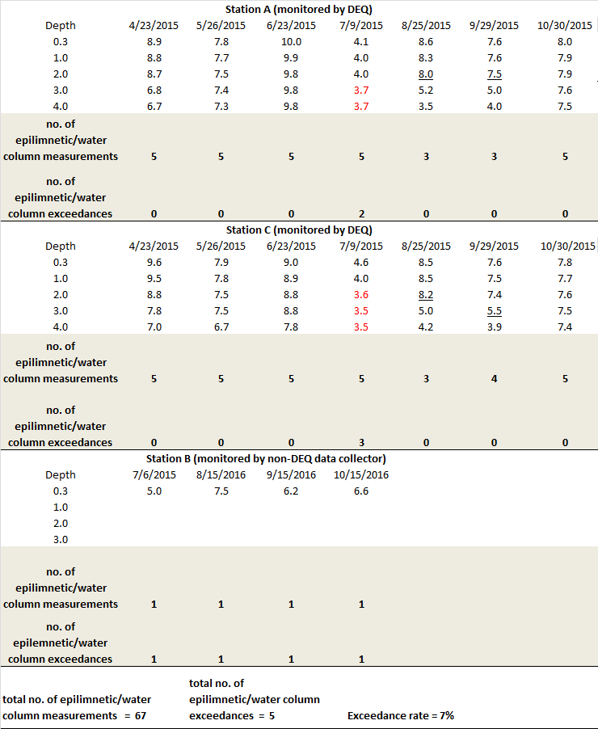
Notes:
Red values are DO criterion exceedance (< 4.0 mg/l).

Slide 27
Problems with this approach!
Only epilimnetic measurements
Only mg/L used, not % saturation
Massive spatial averaging within a profile, over time, and among spatial units
Aggregation over 6-year time span could mask water quality changes

Slide 28
New protocol (feedback welcome)
At every current lake/reservoir assessment unit site, measure a full water column DO profile of both DO in mg/L and % saturation from the subsurface at 0.1 m with every meter interval to the nearest integer meter depth above the sediments (e.g., in 5.2 m deep lake, the water column profile would consist of measurements from 0.1 m, 1.0 m, 2.0 m, 3.0 m, 4.0 m, and 5.0 m).
Establish the depth of the thermocline at that site, if it exists, using the operational definition that the thermocline is the depth that exhibits the greatest temperature change between depths (at least > 1ºC), to delineate epilimnion and hypolimnion.
For each site individually, determine if the median DO concentration of all of the measurements within the epilimnion on a sampling day is below the DO exceedance threshold. Exceedances within the epilimnion are defined as DO concentrations less than 3.0 mg/L. We recommend using this threshold instead of the current DEQ threshold (4.0 mg/L), following the EPA’s guidelines for water quality monitoring (REFS).

Slide 29
If an exceedance is recorded following the DO mg/L criteria above for the epilimnion, examine the % saturation value for the epilimnetic depth profile as described for mg/L. If the median % saturation of the epilimnion of a spatial unit is above 50%, but the DO concentration in mg/L is less than the threshold, the site is not considered impaired.
We note that if the median epilimnetic % DO saturation is above 100% (i.e., supersaturated), then it is likely also an indicator of poor water quality due to high phytoplankton biomass, but without guidance from the EPA, we do not have a supersaturated DO water quality threshold at this time.
For each site individually, determine if the median DO concentration of all of the measurements within the hypolimnion on a sampling day is below the DO exceedance threshold. Given the likelihood of oxygen depletion in the hypolimnion of most reservoirs that is inherent to their construction (see above), we propose a lower DO threshold for hypolimnetic DO exceedances: 3.0 mg/L. We have chosen this threshold to follow the standard established by the EPA to identify disturbed waterbodies (EPA REF).
If an exceedance is recorded following the DO mg/L criteria above for the hypolimnetic, examine the % saturation value for the hypolimnetic depth profile as described for mg/L. If the median % saturation of the hypolimnion of a spatial unit is above 50%, but the DO concentration in mg/L is less than the threshold, the site is not considered impaired.

Slide 30
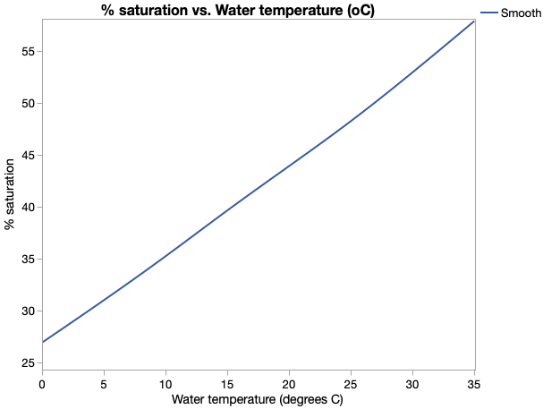

Slide 31
If there is more than one monitoring site within a lake/reservoir assessment spatial unit, aggregate epilimnetic DO concentrations among sites within a spatial unit. This aggregation should be calculated by taking the overall median of the median epilimnetic DO concentrations per site within each lake/reservoir assessment spatial unit for a sampling day.
If there is more than one monitoring site within a lake/reservoir assessment spatial unit, aggregate among hypolimnetic DO concentrations among sites within a spatial unit. This aggregation should be calculated by taking the overall median of the median hypolimnetic DO concentrations per site within each lake/reservoir assessment spatial unit for a sampling day.
If either the median epilimnion or hypolimnion DO concentration of a lake/reservoir assessment spatial unit on a monitoring day is less than the 3.0 mg/L DO threshold, then that spatial unit as a whole is considered to exhibit an exceedance on that day, even if only one of the two water layers exceeded the threshold. It would still be considered to just have one exceedance if both layers on the same day had DO concentrations less than the threshold.

Slide 32
Calculate the total number of spatial unit-sampling days (i.e., the total number of days in which each spatial unit within a waterbody was sampled) over a maximum three-year (not six-year) rolling-window assessment period. For example, if there were three spatial units within one lake and each were measured on 7, 4, and 12 sampling days, respectively, over three years, then there would be 23 total spatial unit-sampling days in that three-year assessment period. The exceedance rate is then calculated as the number of times in which any sampling site exhibited an exceedance over the total number of spatial unit-sampling days (see Figure 3 as an example).
A waterbody is considered impaired for DO if the exceedance rate is >10% for the three-year assessment rolling-window period during April-October months.
For calculating descriptive statistics in further DEQ reports, aggregate data first to calculate month-medians prior to additional analyses vs. pooling all data equally within a year.

